Slide 1

Victoria University Information session
VicStart
Variety studied
Varied success

Slide 2
Have a student looking to get university papers under their belt?
The VicStart program allows students to complete university papers while they are still at school.
We, the school of Mathematics and Statistics (SMS), have two courses you might not know about
Math 161
Stat 193

Slide 3
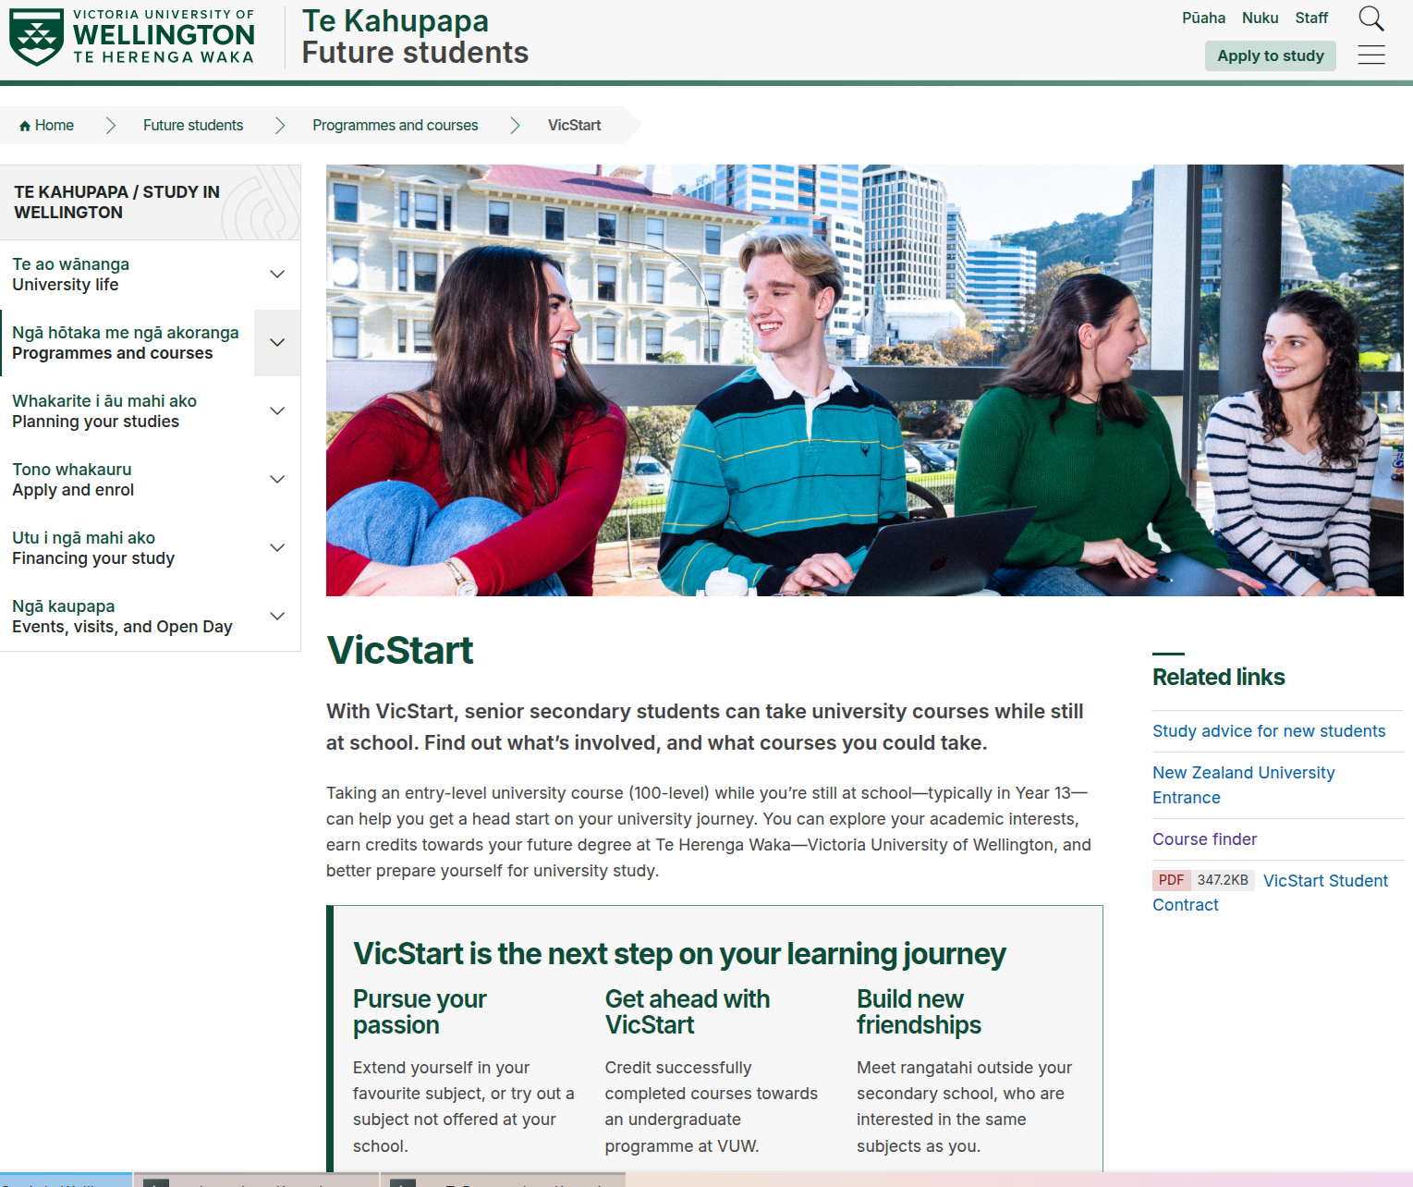
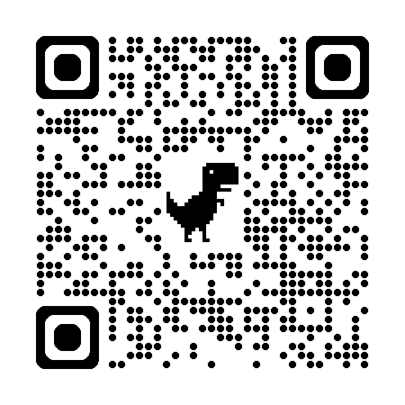
VicStart - Introduction by Glenn Horsfall
https://www.wgtn.ac.nz/study/programmes-courses/VicStart

Slide 4
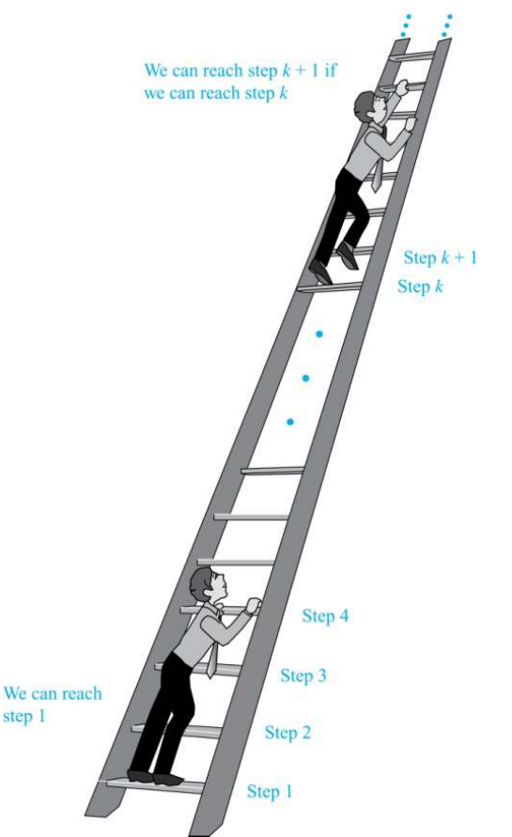
Math 161- Discrete Math and Logic
Runs: Feb-May
(our trimester one)
Content:
Logic and proofs.
Induction
Graph theory
Number theory
Functions and relations
Counting

Slide 5
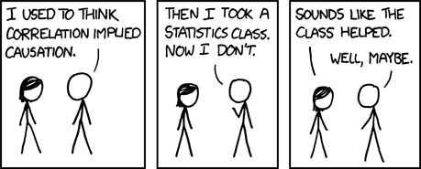
Stat 193 – Applied Statistics
Runs: Feb-May, July-Oct and Nov-Dec
(Runs in all 3 of our trimesters)
Content:
Data display and inference
Probability
Estimation and confidence intervals
Hypothesis testing
Comparison of means
Linear regression and correlation
Analysis of variance (ANOVA)

Slide 6
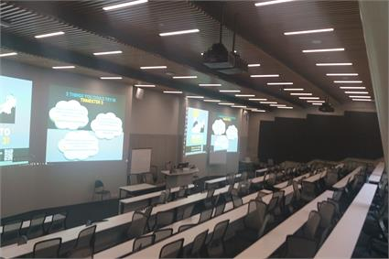
Student success advisors
Students are assigned a student success advisor.
They help students to navigate the university's processes and people.
mailto:info@vuw.ac.nz

Slide 7


SMS majors
Our school manages three majors, Data Science, Mathematics and Statistics
Data science fits in with many other majors, preparing students for the modern world of big data!
Mathematics has a range of areas students can navigate towards, the freedom to choose their specialties.
Statistics helps students interpret and draw conclusions from the information all around us.

