Slide 1

Financial Education

Slide 2
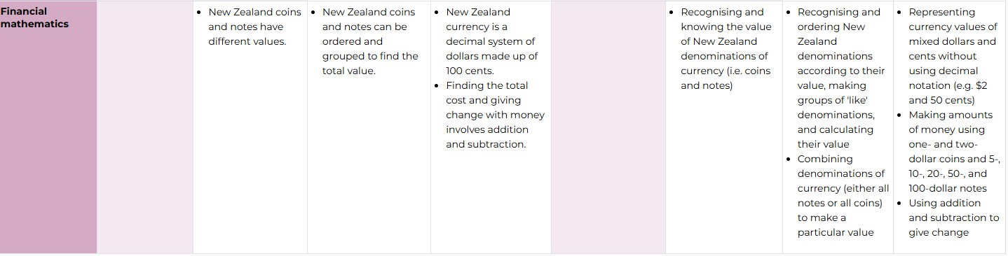
Financial Mathematics
Knowledge
Year 1 Year 2 Year 3
Practices
Year 1 Year 2 Year 3
Notes:
Research shows that adult money habits are being formed by the time children reach the age of seven.
https://www.moneyadviceservice.org.uk/en/static/adult-money-habits-are-set-by-the-age-of-seven-years-old-shows-new-study

Slide 3

Best practices and money topics
Age and stage advice
Mapping of providers

Slide 4

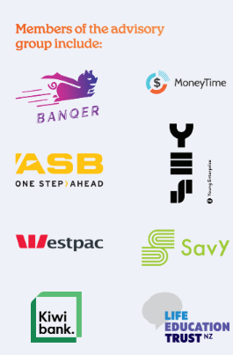


Provider Advisory Group

Slide 5


Slide 6
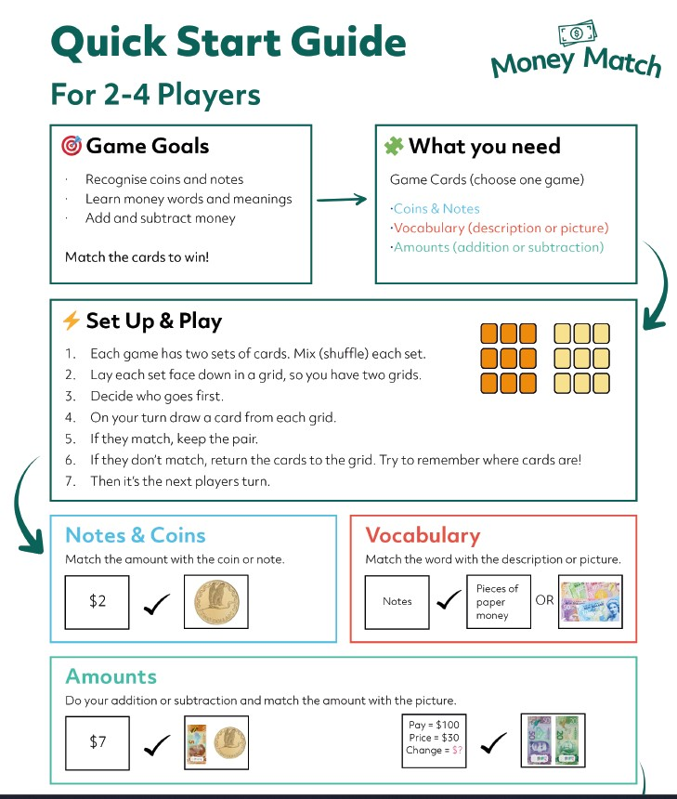

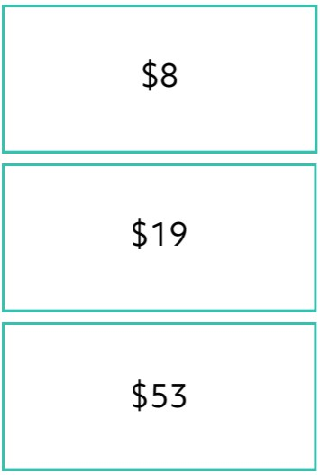
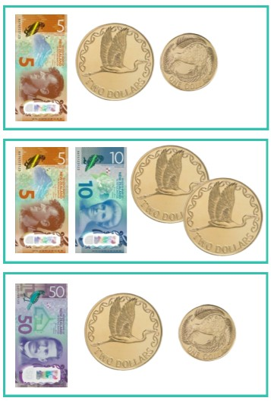

Slide 7
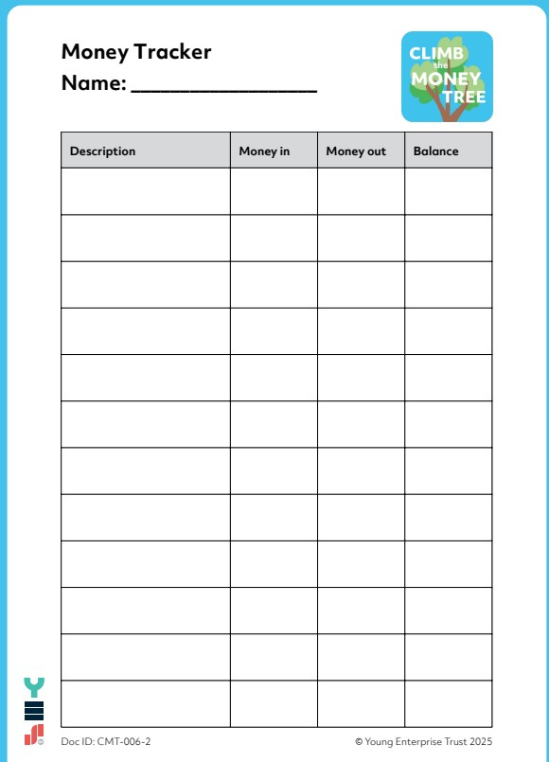
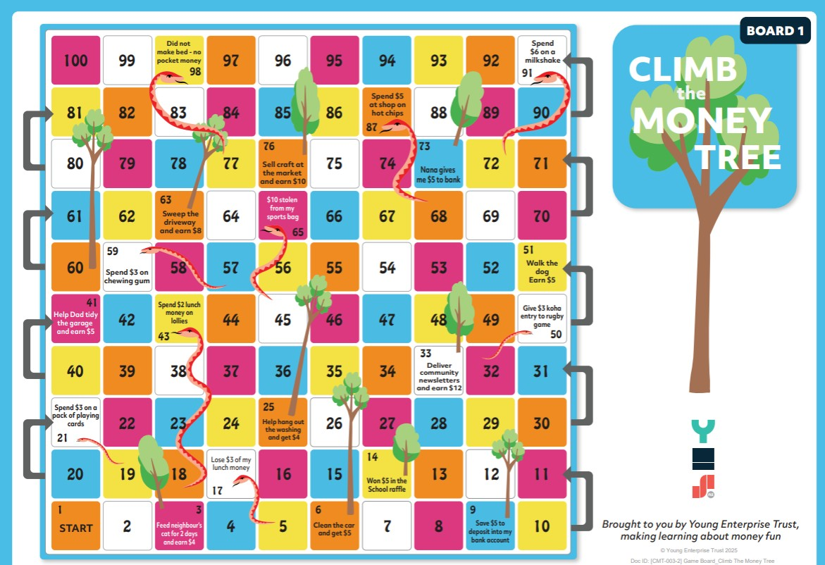

Slide 8
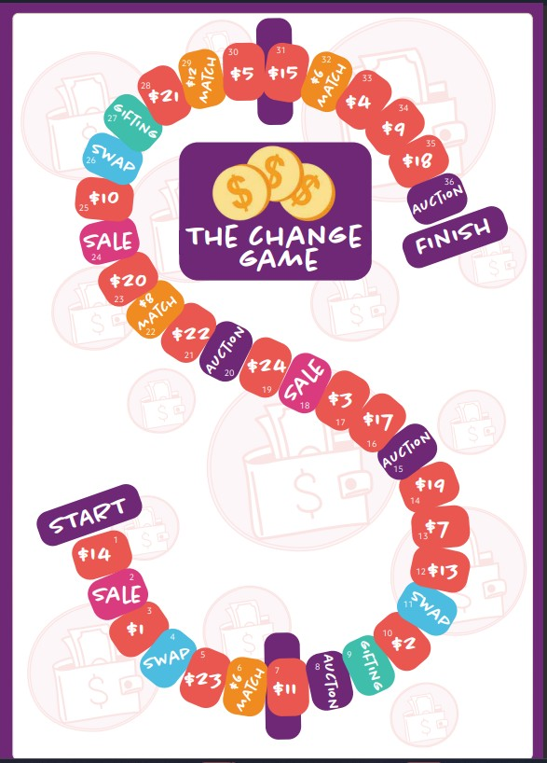
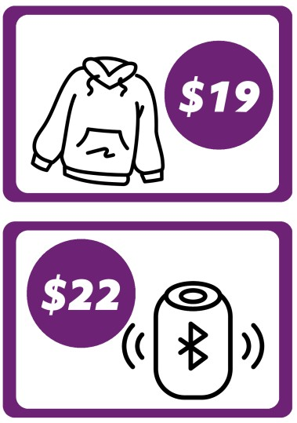
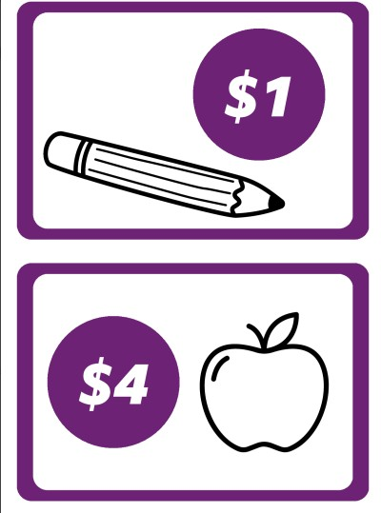

Slide 9
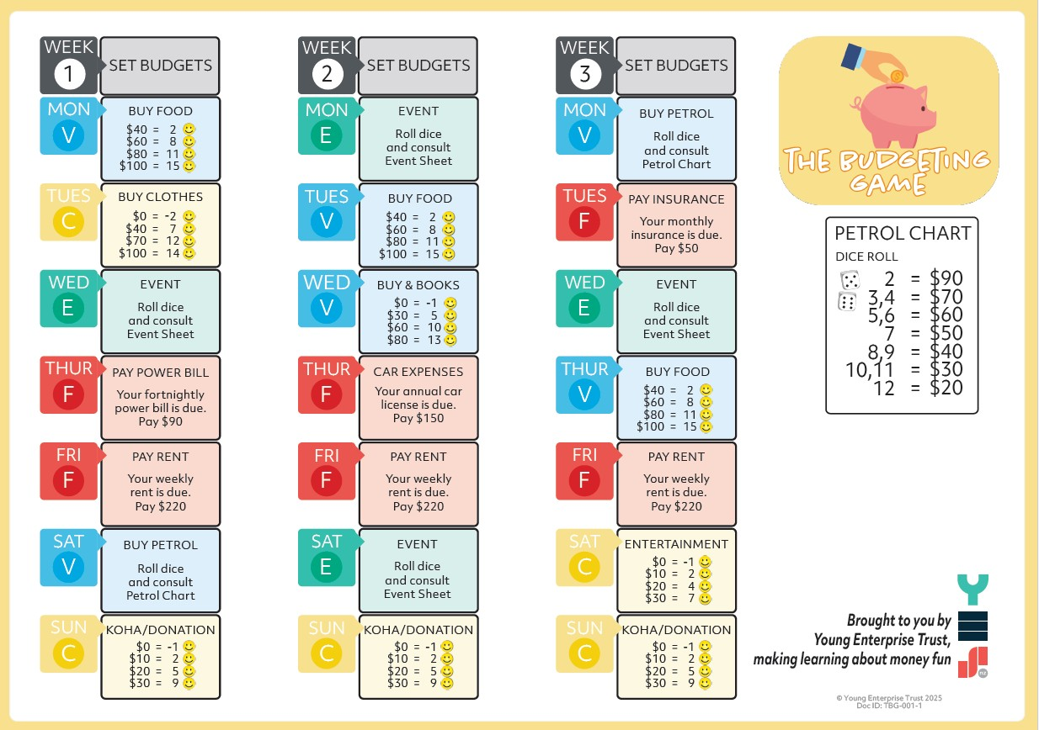

Slide 10
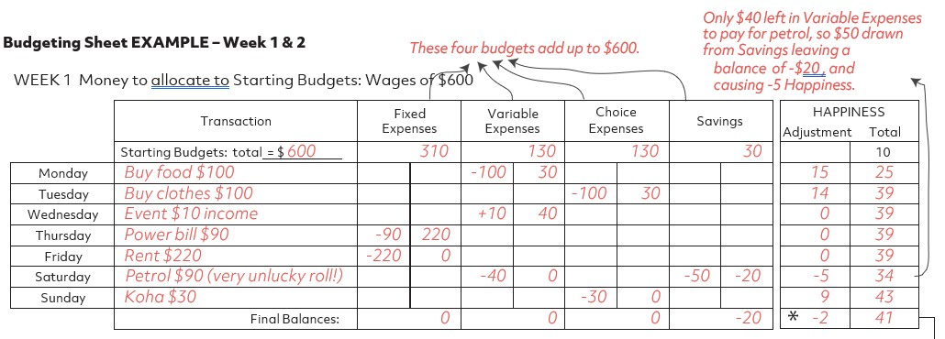

Slide 11

Year
6-10
Cash Courses
Budgeting
Bank Accounts
Impulse Buying
Delayed Payment
Borrowing
Interest
Taxation

Slide 12
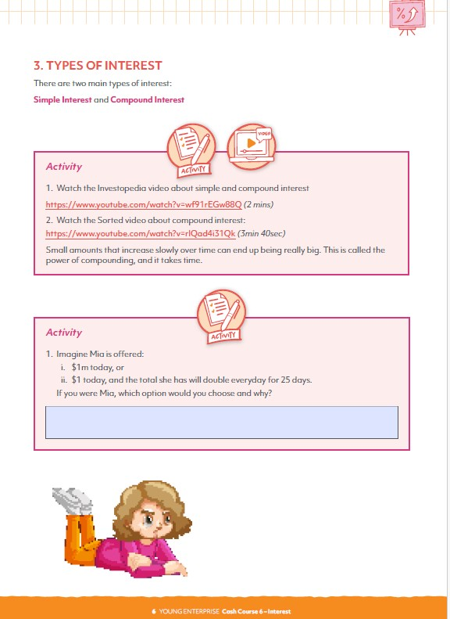
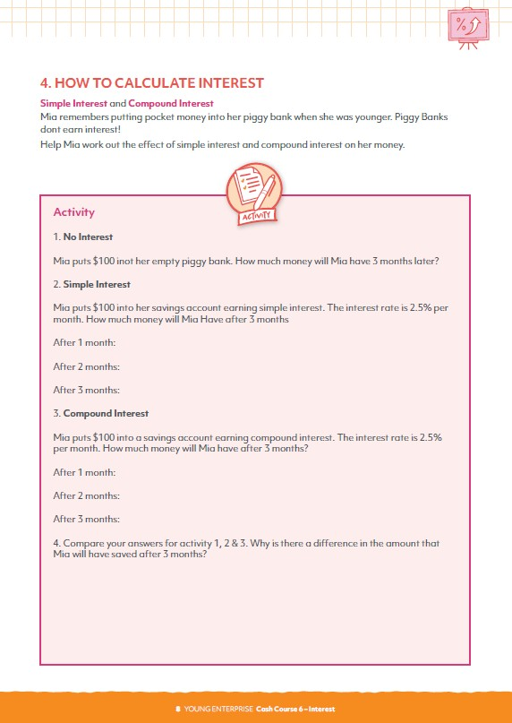

Slide 13
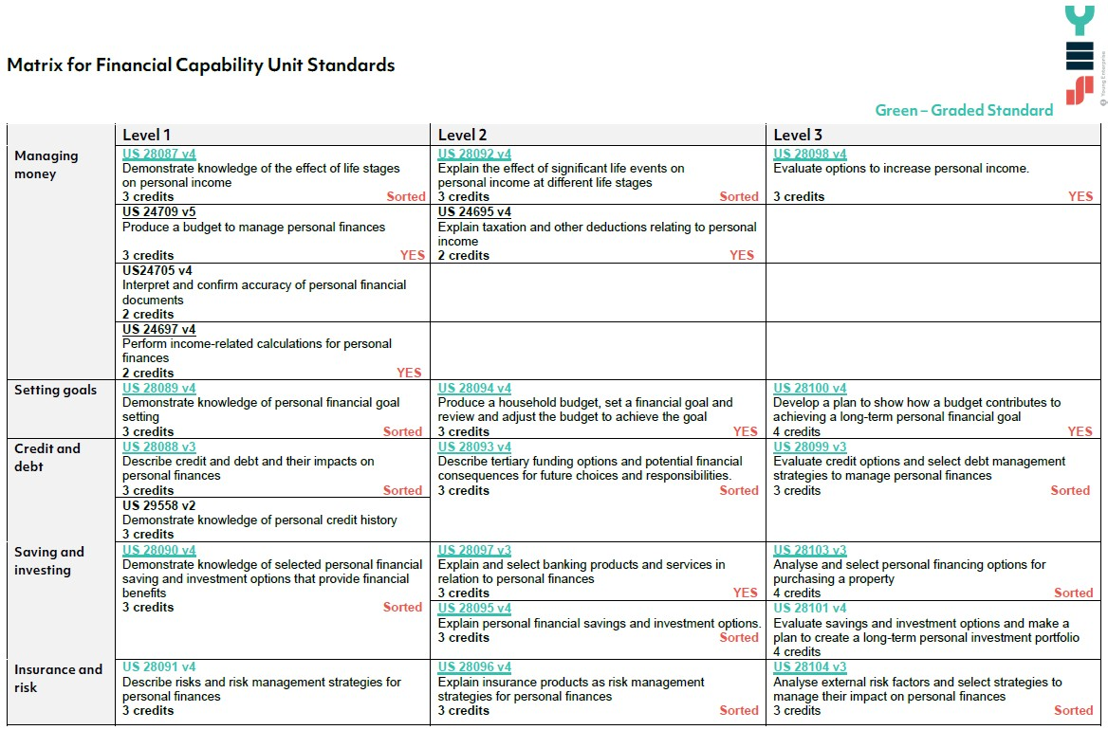

Slide 14
Young Enterprise
paul.newsom@youngenterprise.org.nz

