Slide 1

Crash course in first year Maths and Stats
Topics they'll see again
Topics they likely haven't seen
Discussion on strengths and weaknesses

Slide 2
Setup
The workshop today is about positively exploring the differences between mathematical topics at secondary school and those taught at university.
On the following slides, we collected some problems students might see at uni.
For topics taught in NCEA, similar questions hopefully help us find similarities and differences.
For new topics, we'll explore what experience students bring from NCEA to Uni.

Slide 3
Roots of complex numbers
University : Math 151, mid-course test 2025.
NCEA : Complex numbers and Algebra standard, 2025 exam.

Slide 4
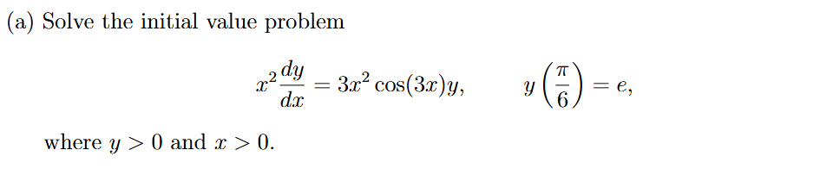
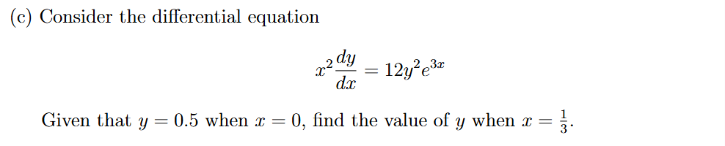
Integration
University : Math 142, final exam 2024.
NCEA : Integration standard 2024 exam

Slide 5
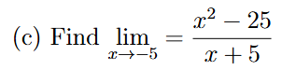
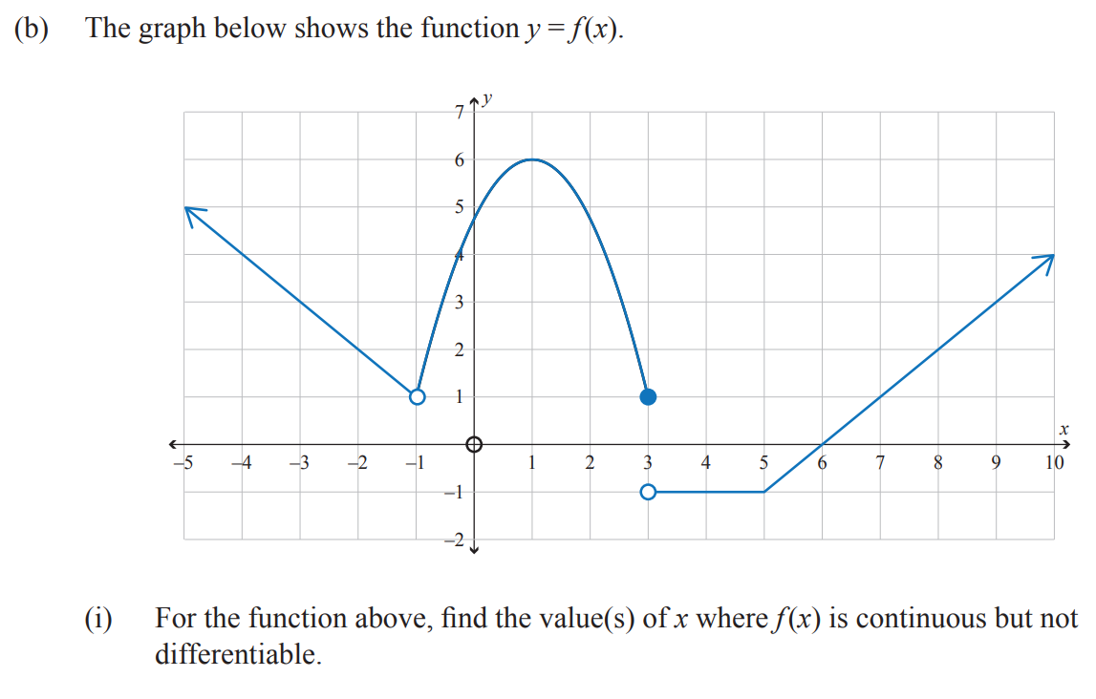
Limits
University : Math 141 2025 exam
NCEA : Differentiation 2025 exam

Slide 6
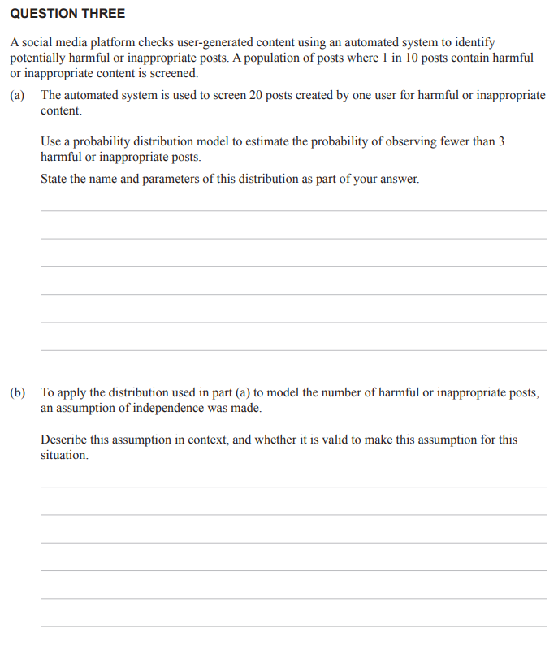
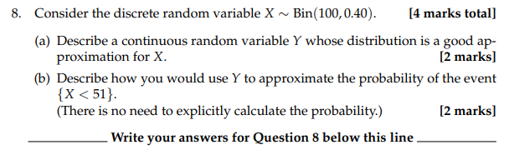
Binomial distribution
University : Math 177 2024 exam
NCEA : Probability Distributions
2025 exam

Slide 7
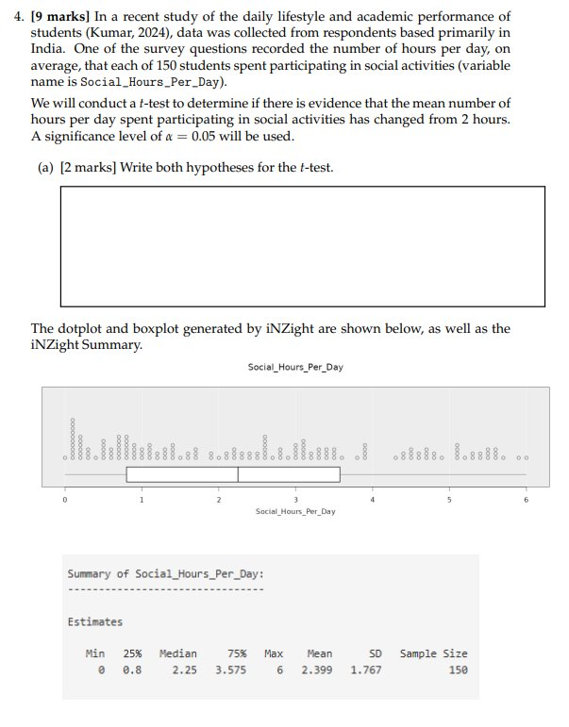
New Stats: t-test
University : Stat 193 2025T2 exam
(Q4).
Continued on following slides

Slide 8
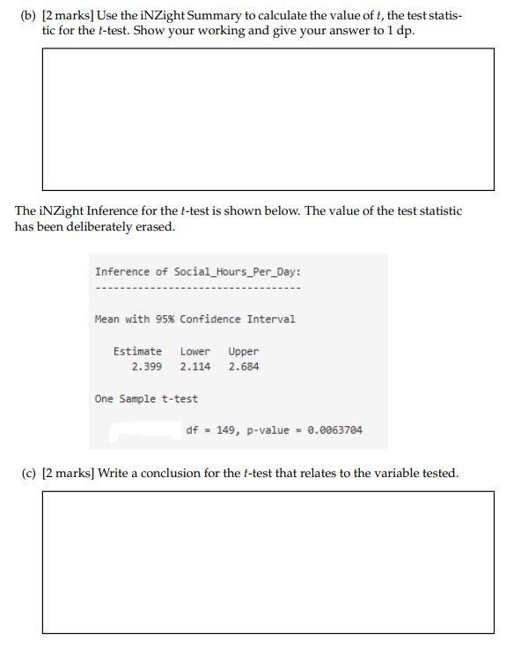
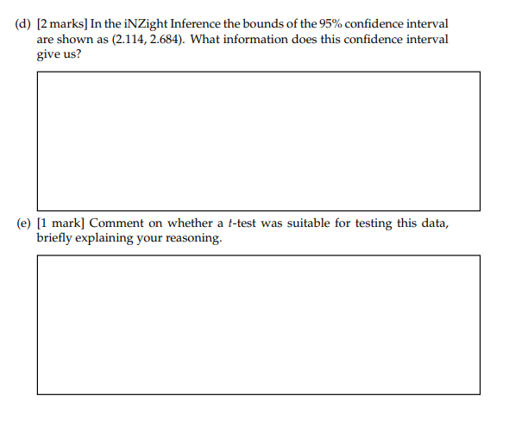
Stat 193 – 2025 T2

Slide 9
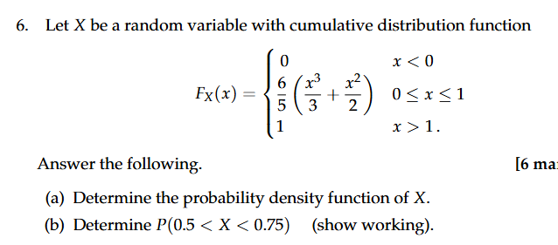
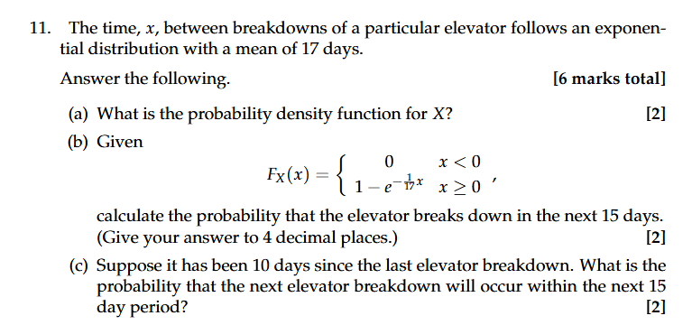
Where Statistics and Calculus Meet
University : Math 177 2025 exam
This is a course that draws from Statistics, Probability and Calculus. It teaches the calculus behind probability distributions. Examples of this can be seen in the displayed questions

Slide 10
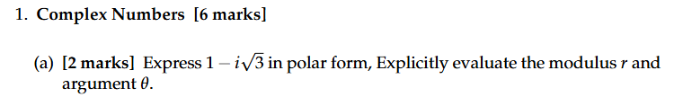
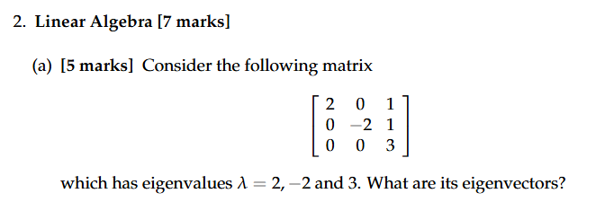
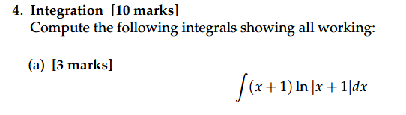
Application: Engineering Mathematics
These courses cover a wide range of mathematical ideas with a focus in application. Some of the content your students will be familiar with, and some will be totally new.
Here are some examples from the ENGR 122 exam 2025

Slide 11
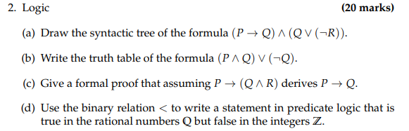
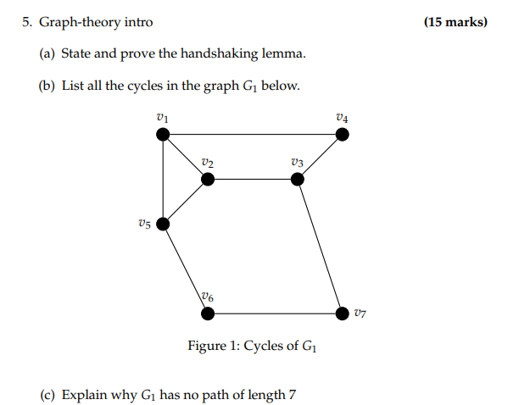
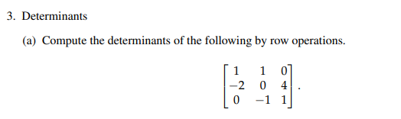
What is new?
Mathematical Logic (Math161 exam 2024)
Graph Theory (Math161 exam 2024)
Matrices (Math 151 exam 2024)

Slide 12
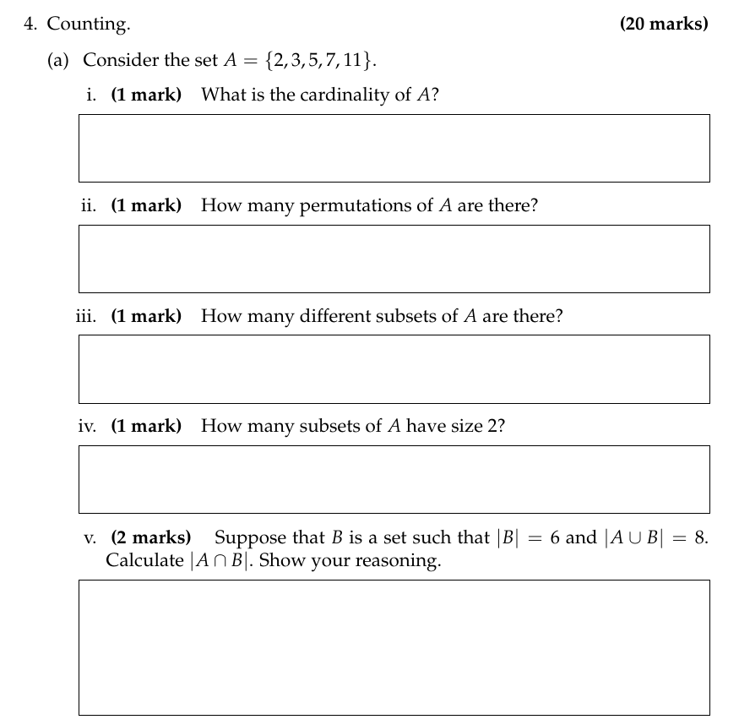
What is new?
Enumeration (Math 161, exam 2025)

