Slide 1
Price optimisation for personal lines insurance
Richard Brookes
26 June 2013

Slide 2
Basic principle
How do we calculate profit?
Conventional solution is as a constant proportion of cost (profit margin), but
By varying the profit margin for different customer segments we can take advantage of how they react to different price levels/changes
This can improve the average profit margin by around 3% of cost whilst retaining the same business volume
Profit
X% of cost
Cost (risk, expenses etc)

Slide 3
Optimisation set-up
Maximise
Average profit margin
By varying
Individual policy premiums
Subject to
A global constraint of the number of policies in force, and
Individual profit margin constraints for each policy, say the interval [-$50, $50] around a “technical” profit margin
To do this we need a relationship between policy price and the number of risks in force

Slide 4
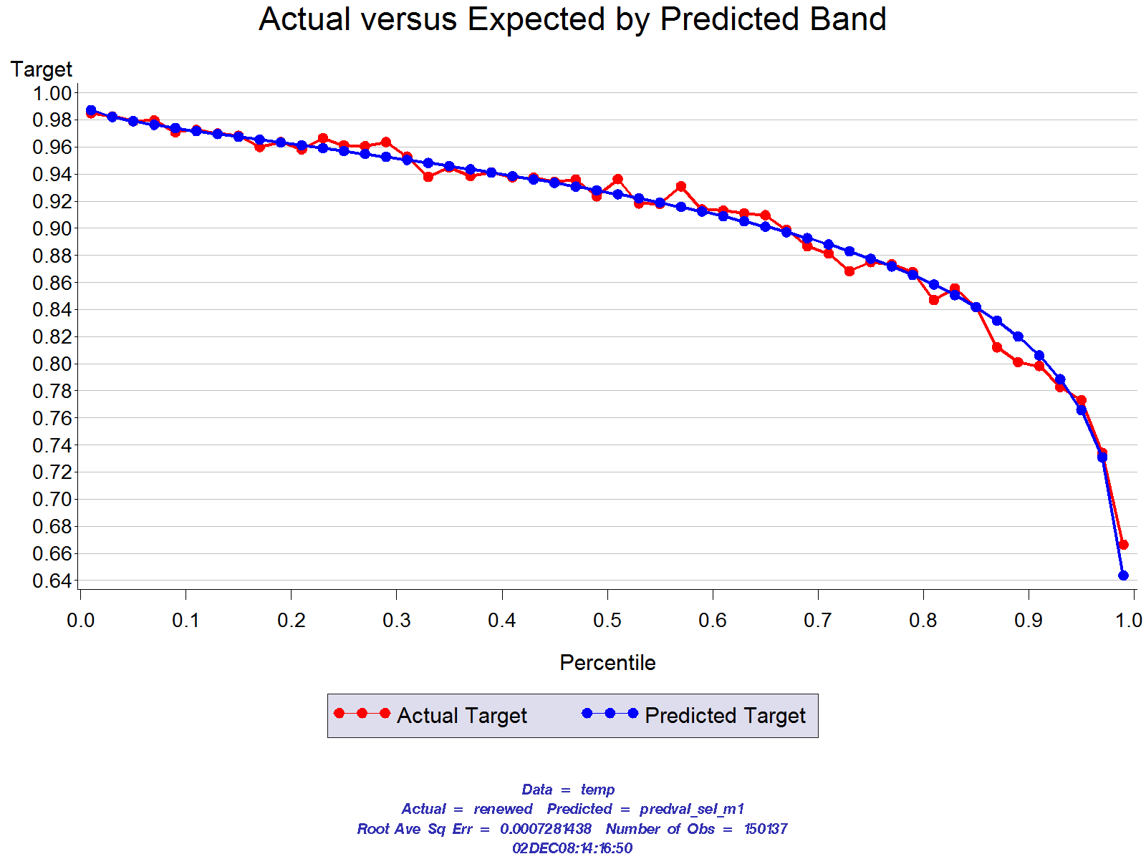
Demand model
Logistic regression model of renewal rate
Policy characteristics just before renewal notice is sent out
Tenure, socio-demographic information
Behavioural indicators
Premium related predictors
Premium increase since last renewal
Premium in relation to competitor premia

Slide 5
Individual demand curves
Combine the objective function, constraints, demand model and an optimisation algorithm

Slide 6
Portfolio results

Slide 7
Distribution of price adjustments
Tend to be less elastic
These policies move to a competitor price or a point of slope change in the demand function
Tend to be more elastic
Caution required - this can lead to a deterioration in the portfolio over time

Slide 8
Optimisation cycle
Data collection
Demand modelling
Projection and optimisation
Ongoing data collection:
Renewal rates and quote strike rates
Price flexing
Competitor rates
Customer characteristics
Statistical models predicting how renewal and strike rates will change in response to price changes
Projections of portfolio volume given price changes
Optimal price changes to maximise profit at given portfolio volumes

Slide 9
The leading edge
The best basic optimisation uses
Price testing and/or competitor rate deconstructions
Hold out segments to assess ongoing effectiveness
Accurate, up to date demand and risk cost models
Monitoring and recalibration of these models is important
Demand models must address slope and level
Leading edge optimisation extends to:
Real time optimisation of new business quotes
Taking into account extra dimensions of behaviour (see diagram to the right)
Optimising over the full expected lifetime of each customer i.e. multi-year optimisation
Optimisation taking into account of the multiple brands offered to each customer
Optimisation taking into account each customer’s multiple product holdings

